Slide 1
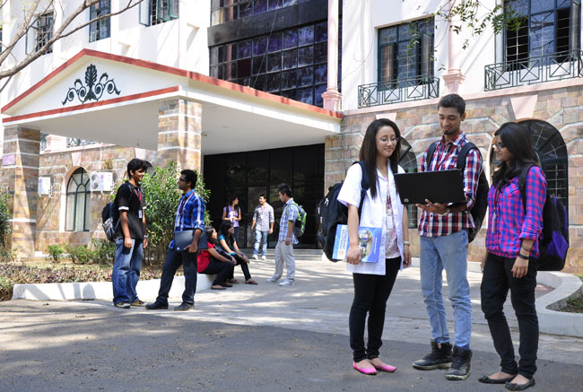

CSB4301 – Theory of Computation
B.Tech – IVth Semester
Mr. D.S.John Deva Prasanna AP(SG)
Department of Computer Science and Engineering

Slide 2
Finite Automata
Automata: A algorithm or program that automatically recognizes if a particular string belongs to the language or not, by checking the grammar of the string.
An automata is an abstract computing device (or machine). There are different varities of such abstract machines (also called models of computation) which can be defined mathematically.

Slide 3
Basic Requirements of Automaton
Every Automaton meets the three basic requirements.
Every automaton consists of some essential features as in real computers. It has a mechanism for reading input. The input is assumed to be a sequence of symbols over a given alphabet and is placed on an input tape(or written on an input file).
The simpler automata can only read the input one symbol at a time from left to right but not change. Powerful versions can both read (from left to right or right to left) and change the input.
The automaton can produce output of some form. If the output in response to an input string is binary (say, accept or reject), then it is called an accepter. If it produces an out- put sequence in response to an input sequence, then it is called a transducer(or automaton with output).

Slide 4
Basic Requirements of Automaton
The automaton may have a temporary storage, consisting of an unlimited number of cells, each capable of holding a symbol from an alphabet ( which may be different from the input alphabet).
The automaton can both read and change the contents of the storage cells in the temporary storage.The accusing capability of this storage varies depending on the type of the storage.
The most important feature of the automaton is its control unit, which can be in any one of a finite number of interval states at any point. It can change state in some de- fined manner determined by a transition function.

Slide 5
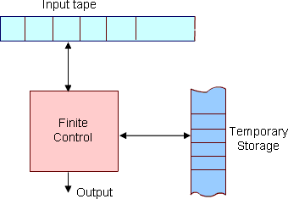
Schematic Diagram of an Automata

Slide 6
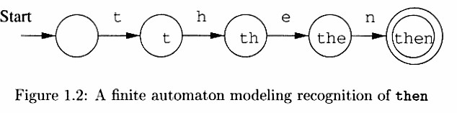
How an automata recognizes a word

Slide 7
Components of an Automata
Finite Automata
Automata (singular : automaton) are a particularly simple, but useful, model of compu- tation. They were initially proposed as a simple model for the behaviour of neurons.
States, Transitions and Finite-State Transition System :
Let us first give some intuitive idea about a state of a system and state transitions before describing finite automata.
Informally, a state of a system is an instantaneous description of that system which gives all relevant information necessary to determine how the system can evolve from that point on.
Transitions are changes of states that can occur spontaneously or in response to inputs to the states. Though transitions usually take time, we assume that state transitions are instantaneous (which is an abstraction).

Slide 8
What is finite Automaton?
Some examples of state transition systems are: digital systems, vending machines, etc. A system containing only a finite number of states and transitions among them is called a finite-state transition system.
Finite-state transition systems can be modeled abstractly by a mathematical model called finite automaton

Slide 9
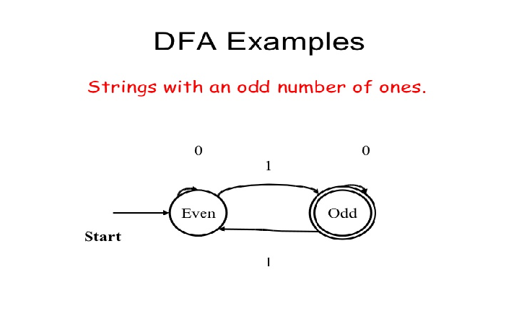

Slide 10
Types of Automaton
Deterministic Finite Automaton - DFA
Non Deterministic Finite Automaton - NFA
Non Deterministic Finite Automaton with Є transitions – Є NFA

Slide 11
Any other ways to represent a language ??
Yes
It is Regular Expressions called as RE
- A simple Mathematical technique for representing languages.
- These are REs are fed as input to the automaton as a reference.
- Based on REs automatons will recognise any given input.

Slide 12
Components of a finite automata
Q: finite set of states
∑: finite set of the input symbol
q0: initial state
F: Set of Final/Accepting states
δ: Transition function
δ (q0,0)=q1
If we reach any one accepting state of the automata upon a series of input then we say the string is accepted

Slide 13
Thank You

